Slide 1

DriverPass System Analysis
Sherry Janes
Notes:
[No speaker notes required for this slide.]

Slide 2

System Requirements
Functional Requirements:
The system shall register/login users when given the necessary information.
The system shall be connected to the DMV and display the latest rules, policies, and sample tests for the customers to practice.
Nonfunctional Requirements:
The application will need storage for the database and website data.
Users should have the ability to reset their password if they forget it.
Notes:
DriverPass has many requirements to run correctly. A functional requirement for DriverPass is for users to be able to register by putting in the information to get the account started; after that, they can purchase packages, schedule appointments, and will be able to access the DMV so that they can practice tests.
For nonfunctional requirements, the website will need to be able to have one or both internal and external storage to save website database data. It is necessary so that when the customer logs off, they can log back in and start where they left off. It will have to have something so that if the user forgets their password, they can reset it. We could send a link to them so they can reset it.

Slide 3
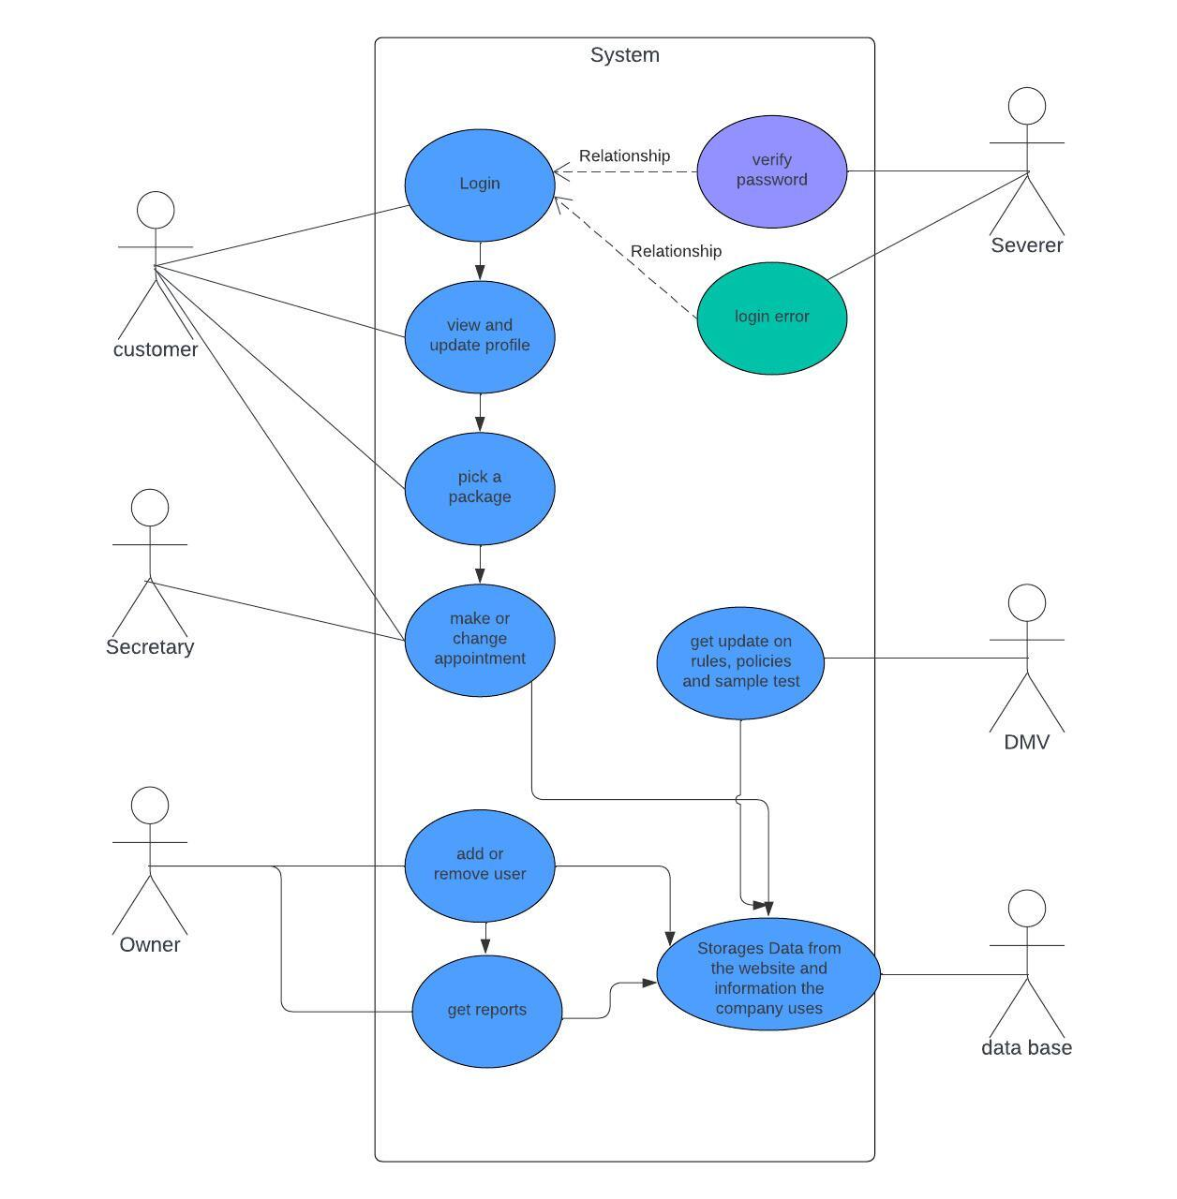
Use Case Diagram
Notes:
This diagram shows the various uses for the Driver Pass application. Certain people will utilize certain functions. We start with the customer, who will need access to tasks like creating an account, purchasing packages, accessing documents, etc… Next, the secretary will also be able to set up customer appointments. The company’s owner needs the ability to create and manage employee accounts. Lastly, the owner needs the ability to create and view reports. There are then functions the users won’t see, like verifying a login done by an authentication service. The DMV document server provides the most up-to-date documents for the customers to study. Finally, the Driver Pass database stores information for reporting purposes.

Slide 4
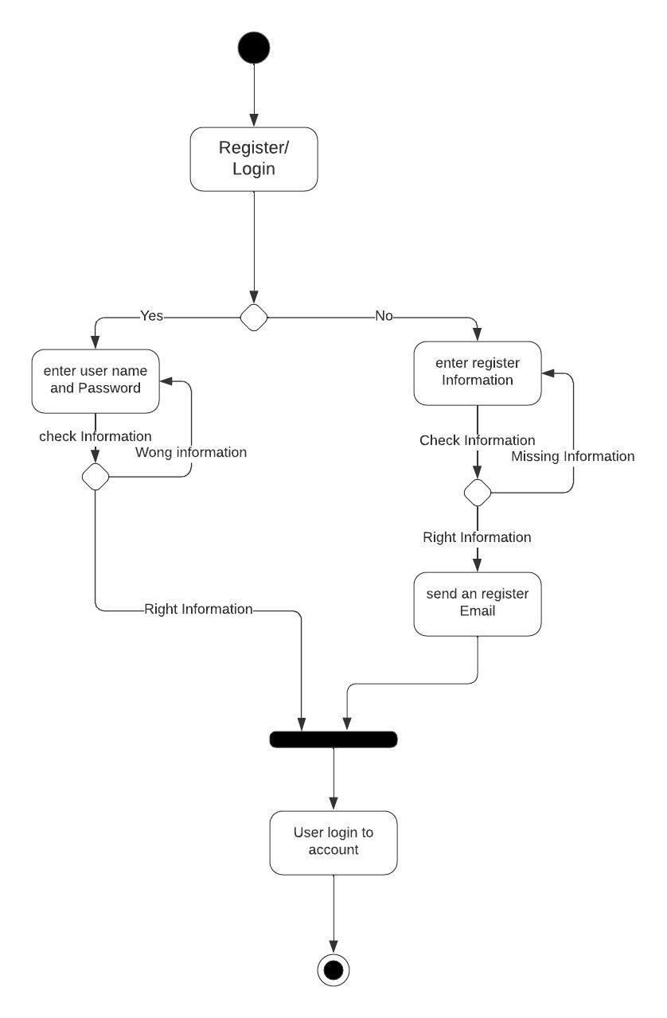
Activity Diagram
Notes:
Driver Pass requires users to create and log into their accounts and save them entirely so no one else can get into them. This activity diagram breaks down how the users can register for an account or log in to an account they have.
By checking to see if the information is right or not. First, it checks to see if you have an account. If you have an account, then you can log in. If you don’t have an account, you will have to register first. To register for an account, you must put in your personal account information first once you are registered, you will get an email confirmation. If you have an account, you can log in, and the system will check to ensure you enter your username and password correctly.

Slide 5
Security
Registered users must authenticate their email address.
Users require a password to log in.
The authorization process stops hackers from getting into used accounts.
Website uses HTTPS rather than HTTP so that sensitive information is sent encrypted.
Notes:
The security feature that we added will ensure that the user’s account is secure so that hackers can’t get their account information. We will be using HTTPS over HTTP. That way, sensitive data like credit numbers and other personal information are encrypted. It makes it more difficult for hackers to steal data. The user will have to use their email as their login username; that way, if they forget their password, they will have 3 attempts to remember it. Or request to reset their password by the server sending them an email so they can reset their password.

Slide 6
System Limitations
Customers in certain regions may have slower access to the website.
The client doesn’t have an on-staff developer.
Notes:
The customer who doesn’t have a strong enough internet connection might have trouble logging in to their account. But once they get into their account things should move well for them. Driver Pass may have to outsource a developer to add a new function to the application. Lastly, it’s possible that certain browsers/devices can’t access the site. This would be a rare situation, but it is possible.

